Slide 1
DATA DASHBOARD PRESENTATION
BY
KRITHIKA B
VEL TECH HIGH TECH

Slide 2

PROBLEM STATEMENT
“Our main goal is to thoroughly analyze past sales data in order to derive insights that will enable tactical improvements.”
-> Carefully Examine Sales Trends, Customer Segmentation, And Product Performance.
->Identify Problem Areas And Develop Focused Tactics That Will Increase Sales, Improve Customer Satisfaction, And Improve Inventory Management For Increased Profitability.

Slide 3

APPROACH
We collected data from multiple sources and used excel to create an interactive dashboard.

Slide 4
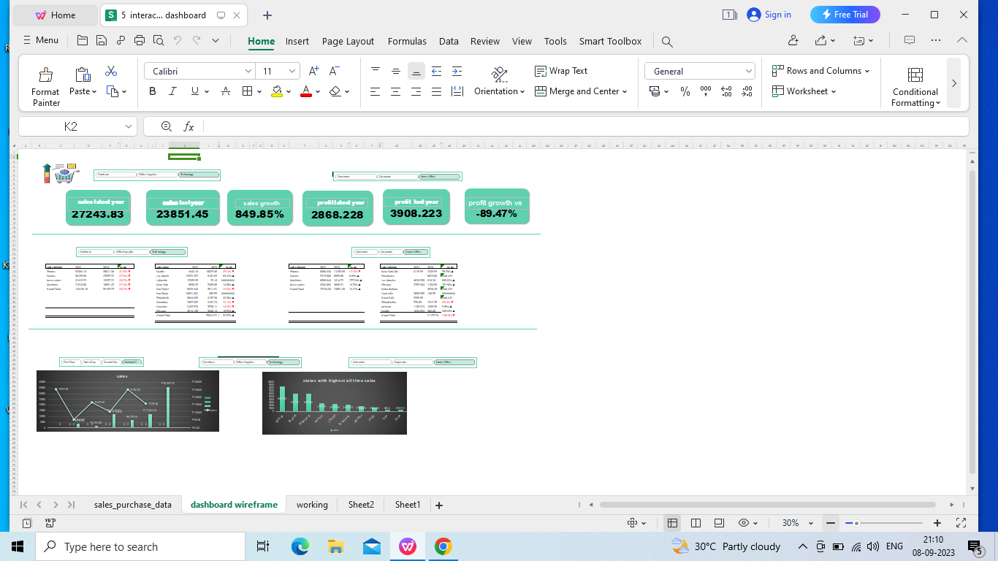
SALES PERFORMANCE DASHBOARD

Slide 5

STEPS TO CREATE DASHBOARD
Step 1 Wireframing Dashboard
Gives An Idea Of All Data Requirements
Helps In Planning
Step 2 Determining Data Points That Will Be Required
Step 3 Setting Up Workings And Pivot Tables
Step 4 Building Up The Dashboard
Step 5 Final Touches Formatting

Slide 6


INSIGHTS
https://drive.google.com/file/d/1Z2_5JG5s5Xn9PiDk0HeeDXpA1tM3vmyE/view?usp=sharing

Slide 7

In conclusion, creating interactive dashboards in Excel can be a powerful way to analyze and visualize data, particularly in the context of sales.
These dashboards can help users gain insights, make informed decisions, and track key performance indicators (KPIs) effectively.
By utilizing features like slicers, pivot tables, and charts, you can present data in a user-friendly and dynamic manner.

Slide 8

DATASET LINK
https://drive.google.com/file/d/15CJbFAduij3L5wfpfirpFp9HVcRBNOQE/view

Slide 9


